Slide 1
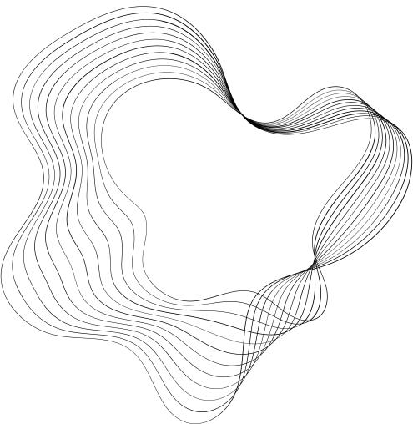

TOOL FOR SIMULATING TUMOR GROWTH IN VARIOUS REGIONS OF THE HUMAN BODY IN THREE DIMENSIONS.
AUTHORS:
CARLOS CARRET MIRANDA
Faculty of Mathematics and Computer Science, University of Havana
REINALDO RODRÍGUEZ RAMOS
Department of Mathematics, Faculty of Mathematics and Computer Science, University of Havana,
Cuba, and PPG-MCCT, Federal Fluminense University, Volta Redonda, Rio de Janeiro, Brazil
PANTERS RODRÍGUEZ BERMUDEZ.
Departamento de Ciencias Exatas, Universidade Federal Fluminense, Volta Redonda, Rio de Janeiro, Brazil

Slide 2

SUMMARY
Cancer is a disease characterized by the uncontrolled growth of abnormal cells in the body. It is a complex and multifaceted disease that has challenged researchers and doctors for decades. . The three-dimensional tumor growth simulation tool that is being developed allows for detailed visualization of tumor growth in different parts of the human body, which can provide valuable insights into how cancer develops and spreads. This tool utilizes a cellular automaton and a small-world network to create connections between cells, allowing for a more accurate representation of organ and tumor structures. Furthermore, it allows for the loading of configurations and parameters from external files, providing great flexibility to the tool and allowing for customization of the simulation to the specific needs of each case. For 3D rendering, the Marching Cubes technique is used, which enables detailed and accurate three-dimensional representation of tumors.

Slide 3
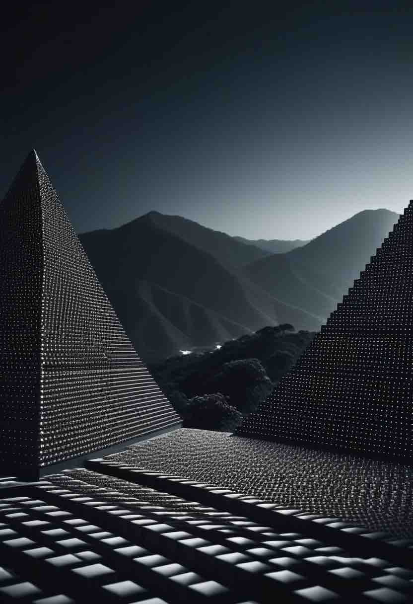



PRELIMINARIES
Cancer is a disease that affects a large number of living organisms and is characterized by the presence of a group of abnormal cells that grow uncontrollably.
The challenge of mathematically, physically, and computationally representing biological phenomena requires interdisciplinary synergy.
The purpose of this type of research is to achieve a deeper understanding of biological processes through an iterative cycle of theory and experimentation.

Slide 4
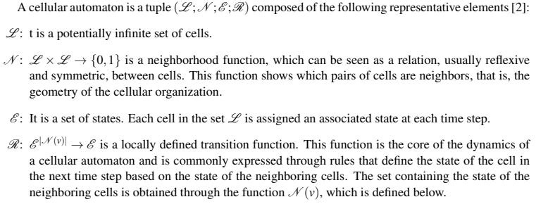
CELLULAR AUTOMATON

Slide 5
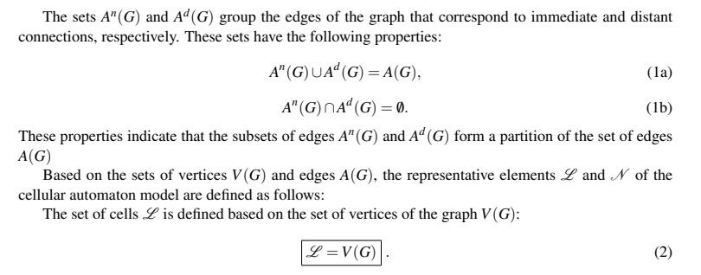
CELLULAR AUTOMATON

Slide 6
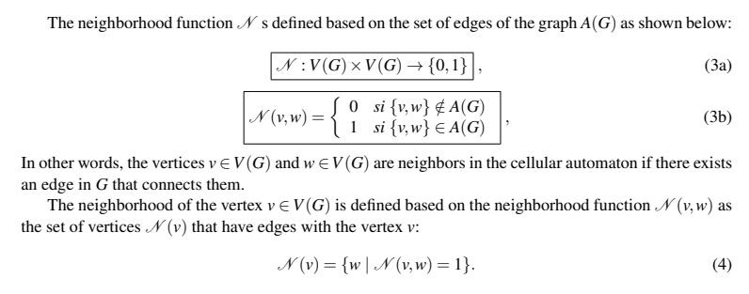
CELLULAR AUTOMATON

Slide 7
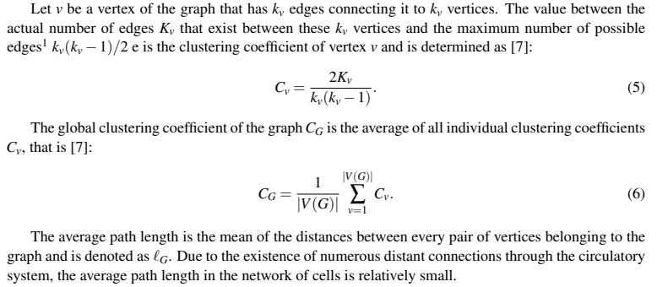
SET OF CELLS: WATTS-STROGATZ MODEL

Slide 8
SET OF CELLS: WATTS-STROGATZ MODEL
The proposed algorithm by the model, which is used to generate the small-world networks used in this work, is as follows:

Slide 9

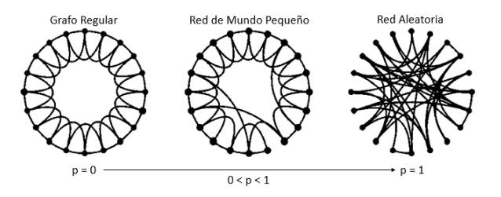
SET OF CELLS: WATTS-STROGATZ MODEL
Start: We begin with a graph with q vertices, e.g. a ring or a mesh, in which each vertex is connected to k immediate neighbors.
Randomization: We randomly reconnect each edge of the graph with a probability p in such a way that there are no duplicate edges or loops. This procedure introduces pqk/2 edges that connect distant vertices. By varying p, we can observe the transition between the order with p = 0 and a totally random graph with p = 1.

Slide 10
MARCHING CUBES
The Marching Cubes technique is a computer graphics algorithm used to extract a polygonal mesh of an isosurface from a three-dimensional discrete scalar field, such computed tomography (CT) scans and magnetic resonance imaging (MRI) data. In the context of this project, it is used for the threedimensional representation of tumors, providing detailed and accurate visualization.

Slide 11
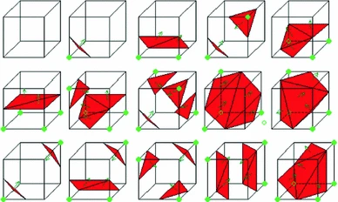
MARCHING CUBES
This algorithm works by processing the cells of volume data (also known as voxels), checking the intersection between their respective edges and the isosurface. The values of each vertex of the cells are compared with a given isosurface value, and these vertices are classified as ”inside” or ”outside” the isosurface. Once the type of intersection is determined, an approximation of the isosurface contained in the cell is constructed by building triangles
Illustration of the 15 basic cases of the marching cubes technique. The green vertices are the ones classified as “inside” the isosurfaces, whereas the remaining as “outside” them.

Slide 12
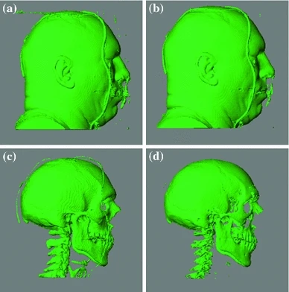
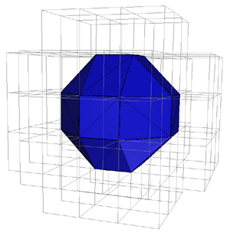
MARCHING CUBES
Volume rendering of a male head dataset using marching cubes with different isovalues: a 30, b 50, c 75, d 100

Slide 13
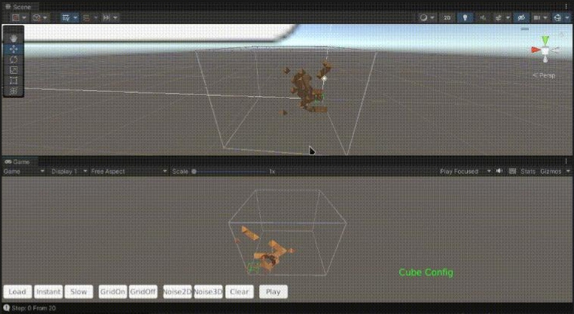
MARCHING CUBES
An example of simulating tumor growth in 3D at early stages.The code was developed in Unity

Slide 14
CONFIGURATION AND PARAMETERS OF THE SIMULATION.
The ability to load specific configurations and adjust, add, or remove parameters that influence the
realism of the simulation allows for the adaptation of the model to different scenarios and conditions.
This makes the tool highly versatile and applicable to a wide range of situations and types of tumors.

Slide 15
PARAMETERS
Sx, Sy, Sz - Dimension of the space declared on the x, y and z axis respectively.
p - Probability of reconnection in the Watts-Strogatz model
Parameters corresponding to the number of states that the automaton cells can have and their descriptions.

Slide 16
PARAMETERS
Parameters for possible transitions between the states of the automaton.
Parameters for the probabilities of the transitions between states.
Parameters corresponding to the shape of the organs where the simulation will take place.

Slide 17
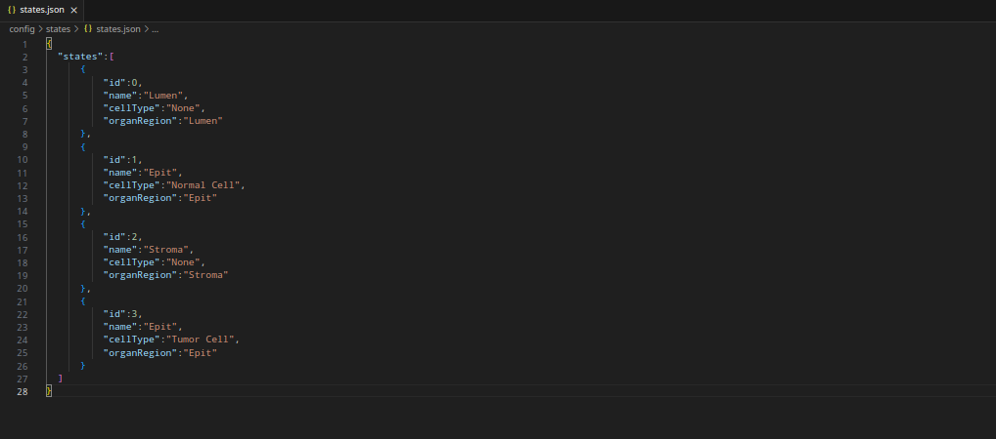
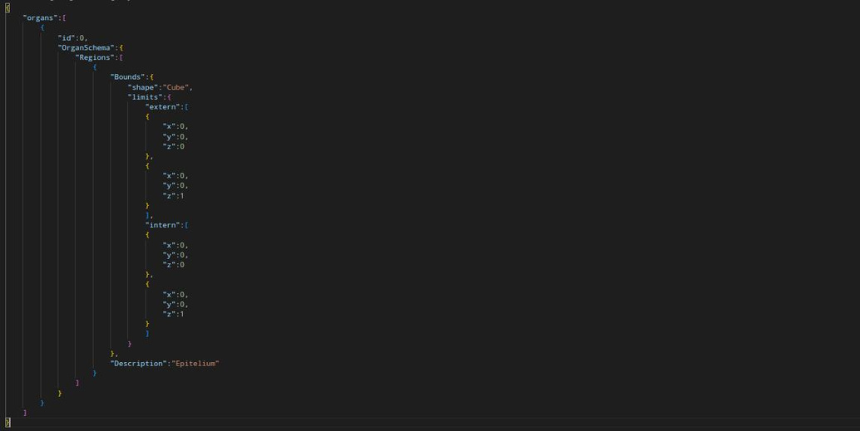
PARAMETERS
states.json
Configuration file for parameters corresponding to the number of states that the automaton cells can have and their descriptions.
organs.json
Configuration file for parameters corresponding to the shape of the organs where the simulation will take place.

Slide 18
CONCLUSIONS
The creation of a tool to simulate tumor growth using cellular automaton in any organ of the human body is a significant advancement in the field of modeling and simulation of biological systems. This tool provides an innovative and flexible approach to studying tumor growth, which has important implications in both basic research and clinical applications.
80%

Slide 19
CONCLUSIONS
The growth of a tumor can be visualized in 3D using the Marching Cubes technique.
The creation of a tool to simulate tumor growth using cellular automaton in any organ of the human body is a significant advancement in the field of modeling and simulation of biological systems.
The ability to load specific configurations and adjust, add, or remove parameters that influence the realism of the simulation allows for the adaptation of the model to different scenarios and conditions.

Slide 20





GOALS AND OBJECTIVES
Objective n° 1
Objective n° 2
Objective n° 3
The loading and usage of parameters for the simulation have been implemented.
The engine to simulate the growth of a tumor in small organs has been implemented.
The cell graph with its connections has been visualized and analyzed.

Slide 21
GOALS AND OBJECTIVES
Objective n° 4
Objective n° 5
Objective n° 6
The size that the tumor will take during the simulation has been visualized.
The code to render the shape the tumor will have has been implemented.
Many other improvements

Slide 22

NEXT STEPS
What will be the focus in the next stages?
Implementing efficient algorithms to process large amounts of cells and their connections, we are
talking about millions of both.
Improving all of the above, for example, enhancing the implementation of 3D rendering using
Marching Cubes to obtain smoother faces and triangles.
Implementing changes between states following the details found in the literature.
STEP 3
STEP 1
STEP 2
STEP 4
Add Artificial Intelligence and Machine Learning techniques to obtain better approximations to reality.

Slide 23
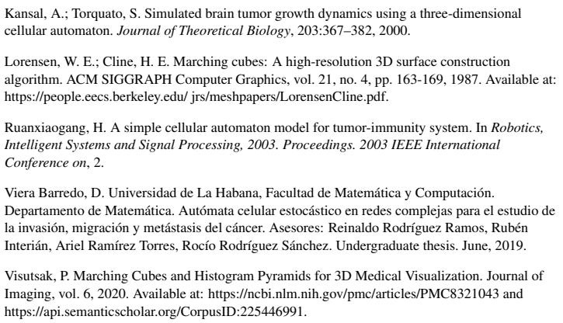
RECOMENDATIONS

Slide 24

THANK'S FOR WATCHING
To be Continued...

